Slide 1
Module 29: Configuring Picklists
Siebel Core Developer and Technology School
Notes:
Time: Lecture: 35 minutes; labs: 55 – 70 minutes
Intent: To describe how to configure two types of picklists in Siebel applications. Students will see how they are administered and how they are defined. It is important to understand the different types and how to set them up so that you can implement the appropriate picklist in the correct place in the application.
Flow: Introduction of picklists, List Of Values table, configuring static picklists, configuring dynamic picklists, and configuring constrained picklists.
Key Terms:
Static picklist
List of Value table
Drop-down list
Dynamic picklist
Pick applet
Constrained picklist
Please note: Faculty-specific notes are italicized.

Slide 2

Module Objectives
After completing this module you will be able to:
  Configure a picklist
  Describe the differences between drop-down lists and picklists
  Administer a list of values
  Configure a drop-down list
Why you need to know:
  Enables you to add picklists to your Siebel application

Slide 3
Picklists
Allow users to populate one or more single value fields by selecting a value from a list
  Enforces business rules and polices
  Makes data entry faster
  Reduces errors
Can be either:
  Static
  Dynamic
Notes:
This slide lists a few important uses for picklists, and mentions they come in two types. The two types of picklists are Static and Dynamic; we discuss the features of each and how to implement them in the following slides.
A picklist is a mechanism of presenting to users lists of values to select from in the UI. They are associated with the field of the business component (underlying the applet of the UI).
Because users are presented with a list of appropriate values this means they do not have to remember all the possible valid entries. This reduces errors and makes data entry faster.
Administrators can determine the values that appear to a user, and only allow data entry from the presented list, therefore enforcing some policy or business rule. Both allow the developer to present the user with a list of values to choose from when entering or updating data. However, they serve different purposes and although they share some configuration similarities, each has their own specific properties necessary for implementation.
The following slides examine in detail how to configure each of these picklists and where to use them.

Slide 4
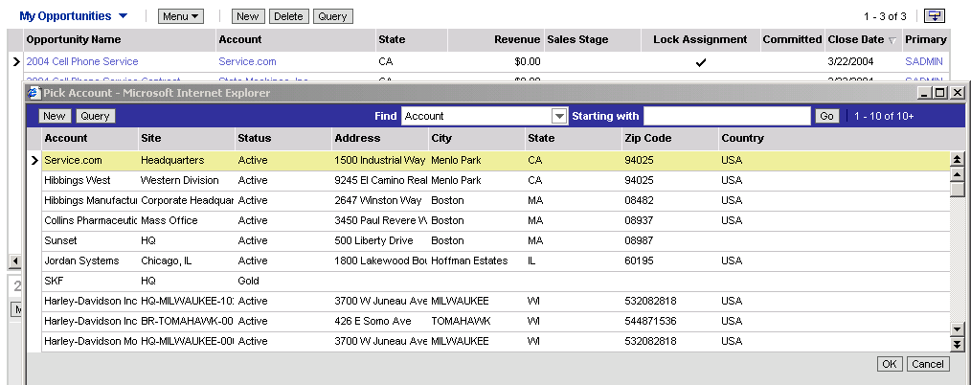
Picklist Terms
Siebel applications picklists:
  Are associated with a field in the originating business component
  Draw values from a pick business component
Opportunity: originating business component
Account: pick business component
Notes:
This slide identifies two terms (originating and pick business components) that are used when configuring picklists for Siebel applications.
The slide shows an example of a dynamic picklist. The two key points are:
To which application element is the picklist attached?
From where do the values come that populate the list?
Point 1, sub-bullet 1: A picklist is an object definition associated with a field on a business component. The originating business component simply refers to the business component that contains the field with the picklist associated to it. In Siebel Tools, there is a property called “Picklist” on a field object type and the name of the picklist would be specified here.
In the case of this slide, it is the Account Name field on the Opportunity business component. So there will be a picklist object definition associated with that field.
Point 2, sub-bullet 2: The phrase pick business component simply refers to the business component that stores the values that will be displayed to the user. In the case of this slide, the pick business component is the Account business component as the values that are displayed to users are Account values.

Slide 5
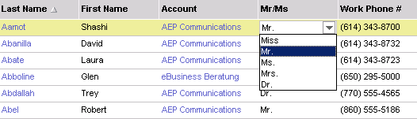
Static Picklist
Draws values from picklist data managed by an administrator
  Values displayed in static picklists do not change during run time
Displays values in a drop-down list for user selection
Copies the selected value into destination field
  No link to the original picklist data
Can be bounded or unbounded
  Bounded picklist forces users to enter only a value in the picklist
  Unbounded picklist permits users to enter any value into the field
Drop-down list
Notes:
This slide shows a screen shot of a static picklist being displayed in a drop-down list box. The arrow icon that appears on the Mr/Ms list column is a visual cue in the UI that a drop-down list of values is available.
The values that appear in the box for the static picklist are managed and administered by the administrator using the administration views (Administration – Application > List of Values or List of Values Explorer). Values are only displayed if the administrator has first entered them. If a new value is required, the administrator needs to add it to the list. They do not change during run time, hence the term “static.”
When a user selects one of the values from a static list of values, that selected value is copied from the table that stores those values (the S_LST_OF_VAL table) into the destination field for the current record. So in this case the value “Ms.” is copied from the list of values table into the Mr/Ms field (PERSON_TITLE column) of this contact record. Note it is copied and not referenced, so no link exists between the copied value and the original picklist data.
Bounded: The user is restricted to selecting values from the presented list only. If another value is entered it will not be accepted and the list will be presented to the user again.
Unbounded: The user may choose from the presented list OR enter a value that is NOT in the list.

Slide 6
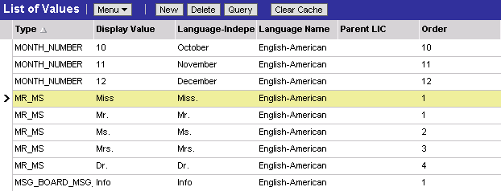
The S_LST_OF_VAL Table
Holds picklist values for all static picklists
Exists in the application database
Has values entered through List of Values Administration view or by batch loading
Access to view is typically
limited to administrators
Specifies a value in the MR_MS picklist
Notes:
This slide explains where the picklist data is stored. There is another record with a display value of the Picklist name and a type of LOV_TYPE. You might choose to demo this in the application.
S_LST_OF_VAL is the Siebel table that stores the names and values for all static picklists. It is administered through the List of Values view. You may enter values through this view by adding records or using the batch mechanism (EIM: Enterprise Integration Manager).
If an administrator wishes to add another value to an existing list they would do it here.

Slide 7
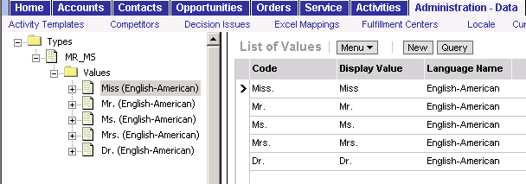
Administering a Picklist
Select Administration – Data > List of Values Explorer to administer static picklist data
  Select an existing picklist or create a new picklist type in the List of Values - Types applet
  Expand the type and select the child Values folder
  Edit the picklist values in the List of Values (LOV) applet
Do not change names of Siebel-supplied values
Notes:
This slide shows the recommended view to perform picklist administration. The explorer view shows the picklist names and picklist value records together.
List of values data is part of the Siebel seed data, which is included with every Siebel application and is not application- specific.
To set up your organization’s lists of values, use this administration view.
Any user that logs on after you add the new value will see it. To see the new value you just entered (as the administrator), you need to log out and then log back in to the application OR clear the cache.
To clear the cache, select Administration - Application > List of Values Explorer view and select Clear Cache from the applet menu.

Slide 8
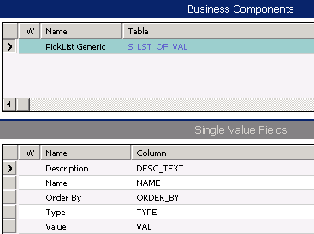
PickList Generic Business Component
Is a Siebel-supplied business component that references the S_LST_OF_VAL table
  Static picklists are based on PickList Generic
Notes:
This slide introduces the Siebel business component that is used to access the S_LST_OF_VAL table. Access to Siebel application tables is achieved through a business component (in the business layer).
To get access to data in the S_LST_OF_VAL table, Siebel Systems has provided a special business component. It allows us access to all the data in that table. If you look inside Siebel Tools at the Table property for the business component called Picklist Generic, you will see that it references the S_LST_OF_VAL table.
When we wish to show ONLY a subset of values from that table (that is, only those values associated with a particular static list that we defined using the List of Values administration views), then we need to tell the application to filter out all the other lists of values. We use the Type and the Value fields to do that. We will see that later as we go through the next set of slides “Creating a Static Picklist”.

Slide 9
Creating a Static Picklist
Create object definitions to:
  1. Define the static picklist
  2. Specify the field to be populated by picklist
  3. Specify mapping between picklist and the originating business component field
  4. Enable the user to invoke the picklist
Can possibly use an existing LOV Type
Notes:
This slide outlines the steps you need to follow to create a static picklist. These steps are performed using Siebel Tools to define and implement the static picklist, NOT the administration of the values we have just seen in the previous slides.
Note that you may be able to use the values of an existing static picklist. In that case you might use something like a search specification to restrict the actual values that come back from the list.

Slide 10

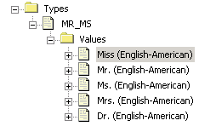
1. Define the Static Picklist
Create a Pick List object definition
  Set Business Component property to PickList Generic
  Set Type Field property to Type
  Set Type Value property to picklist name in S_LST_OF_VAL
  Set Bounded property to TRUE for bounded picklists
Notes:
The slide shows the steps to define the static picklist. In Siebel Tools, create a picklist object definition and set the properties identified in the slide. Provide a name that is unique among picklists, as references to the picklist are done through its name.
Business Component is the name of the business component whose data makes up the list of valid values. For a static picklist this is always the “Picklist Generic” business component as this holds the data for all static picklists. The way we restrict that data to only one static picklist is by specifying the Type Field and Type Value property values. We set the following:
Type Field to ‘Type’; this refers to the field on the picklist generic business component called Type.
Type Value to <picklist name as specified in the S_LST_OF_VAL table>, for example ‘MR_MS’ (shown in slide); where ‘MR_MS’ is the name of the static list of values defined in the administration views. Type Field and Type Value are used together to allow the application to only retrieve the values for a specific static list of values.
Bounded: If set to TRUE, then the user is restricted to entering values that are specified in the list. If set to FALSE, then the user may enter a value that is not specified in the list. The default is FALSE.
Search Specification: You may set this if you want to further restrict the values that come back from the static list of values. The default is FALSE.
For example ‘MR_MS’ (shown in slide); where ‘MR_MS’ is the name of the static list of values defined in the administration views. Type Field and Type Value are used together to allow the application to only retrieve the values for a specific static list of values.

Slide 11
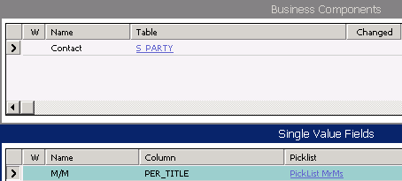
2. Specify the Field to Be Populated
Select the single value field to be populated
Set the PickList property to the name of the static picklist
Name of the PickList we defined in Step 1
Notes:
This slide shows the picklist ‘Picklist MrMs’ being associated with a field in the (originating) business component.
Now, once you have defined the static picklist in the picklist object definition, you will need to specify the field that you wish to associate with this picklist value. You can do this in the business component.
What you will need to do is navigate to the business component object in the Object Explorer and select a business component. Then you will need to navigate to the Single Value Field object and pick a field to associate with the picklist. In the example above, we are using the M/M field in the Contact business component.
In the picklist property of this field we will populate the name of the picklist that we just defined in step 1. Therefore this slide shows the picklist ‘PickList MrMS’ being associated with a field in the (originating) business component. The value from the S_LST_OF_VAL table will be copied from that table into the M/M field of this contact record.

Slide 12
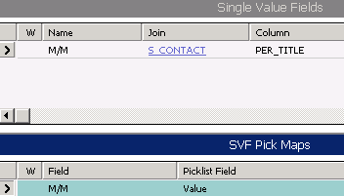
3. Specify Mapping
Create a SVF Pick Map definition
  Set Field property to the field to be populated
  Set Pick List Field property to field in Picklist Generic to copy
    Usually copy the Value field (VAL column)
Indicates to pick from the Value field in Picklist Generic (maps to VAL in S_LST_OF_VAL)
Field in originating BC
Notes:
This slide shows how to create a SVF (single-value field) Pick Map definition that specifies what field is to be populated with what data from the picklist.
Step 3 in creating a picklist is to create a Single Value Field Pick Map definition. This step determines what field will be populated when a picklist value is selected and what data to copy.
You will need to navigate to the SVF Pick Map when you have the Single Value Field selected. From here you will need to add a new record and set the Field and Pick List field properties. The Field property should be populated with the field that will ultimately be populated with the value selected by the user. In this case we are choosing to populate the M/M field with the data that the user selects from the picklist.
The Pick List field property will need to be populated with the field on the PickList Generic business component that will be copied back into the field specified in the FIELD property. That would usually be the field called ‘Value’. (Recall that the Value field refers to the Value column on the S_LST_OF_VAL table).

Slide 13
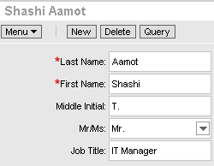
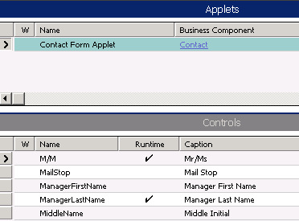
4. Enable the User to Invoke the Picklist
Identify the list column/control that references the field with a picklist
  Can involve multiple applets
Set the Runtime property to TRUE
  A drop-down arrow appears as a cue
Runtime set to TRUE
Notes:
This slide discusses the steps to allow the picklist to be invoked by a user.
Step 4 in creating a picklist is enabling the user to invoke the picklist.
In the UI object which is usually the applet, we need to tell the application that extra processing is required when displaying this list column or control. We do that by specifying Runtime to True. Once this is done, a drop-down arrow will display in the UI when the column or control is accessed, as a visual indication that a picklist is available for this list column/textbox.
To set this property, you will need to navigate to the Applet object in the Object Explorer and select the applet that contains the column or control for which you are creating a picklist for.
You will then need to navigate to the Controls object for the applet and select the control that is to contain the picklist. From here you can set the runtime property for the control.

Slide 14
Lab
In the lab you will:
  Create a new static picklist
Notes:
See lab instructions – Lab 29-1

Slide 15
Drop-Down
Is used to display values for a static picklist
Is auto-generated at run time
Notes:
A static picklist is displayed using a standard drop-down list. It is automatically generated by the application; we do not need to configure anything to have this appear once we have set Runtime=TRUE on the list column/control as stated previously.

Slide 16
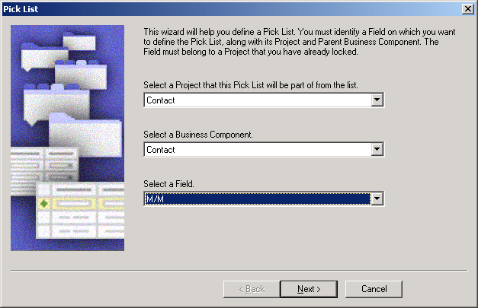
Pick List Wizard
Use the Pick List wizard to create a new static picklist
  Select the originating business component and field
  Select an existing picklist or create a new one
    Wizard adds the new picklist values to the S_LST_OF_VAL table
Set Runtime property on list columns or controls to TRUE to enable users to invoke the picklist
Notes:
This slide shows the Pick List Wizard that can perform all the configuration that was described in the previous slides.
Recall that with our static picklist there are a set of values stored in the S_LST_OF_VAL table (which you can administer through the administration screens of the application) as well as the picklist definition we create in Siebel Tools. The wizard creates this list of values in the S_LST_OF_VAL table AND the picklist object definition that is stored in the repository.

Slide 17

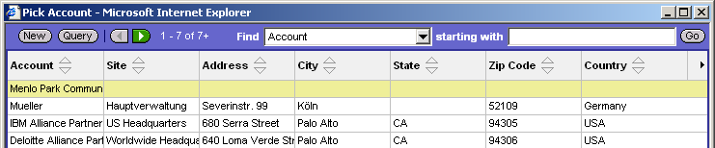
Dynamic Picklist
Draws values from a business component with records edited by users
  Values displayed in picklist change during run time
Is used to update joined fields
Copies foreign key reference to the selected value into destination field
  Reflects the current data in the database
Displays values queried from the Account BC
Notes:
Now that we have covered static picklists, we will focus our attention on dynamic picklists. An important thing to note about dynamic picklists is that they have a different purpose than static picklists. The difference in purpose for dynamic picklists (vs. the static picklist) is that they are used to update joined fields. Now recall that by default, when you create a joined field in a business component, it is read-only. Therefore if you want to provide your users with the ability to update these joined fields, you must associate a dynamic picklist with the joined field.
When the user picks the record from the pick applet (like this example of the Account record) what happens is the primary key of that joined record in the table is copied to the foreign key field in the originating business component (Opportunity BC in this case). Note that the values in the pick applet are coming from the Account business component and not the PickList Generic business component. The values that are displayed to users are the values that exist in the data table underlying the business component.
So in this case the number of account displayed reflects the number in the database. If there are 10 in the database when the user invokes the picklist, then 10 will appear. If another two are added and the picklist is invoked, then 12 will appear. That is the ‘dynamic’ nature of the picklist, hence it’s name.
Now before we continue, we will discuss how a static picklist differs from a dynamic pick applet:
A static picklist does not draw values dynamically from a pick business component. A static picklist is a static list of available selection values. Configuration of these values is an administration activity that is performed in the List of Values Administration view in a Siebel application.
A static picklist generally does not invoke a dialog box with multiple list columns and buttons. All that appears is a simple one-column pop-up list, without buttons.
And finally, static picklists differ from dynamic picklists in that static picklist does not populate multiple controls in the originating applet. It populates a single control in the applet, and the corresponding field in the underlying business component.

Slide 18
Creating a Dynamic Picklist
Create object definitions to:
  Define the dynamic picklist
  Associate the picklist with a field
  Specify mapping between the pick BC and and originating BC fields
  Identify an existing pick applet (or create a new one) to display the pick data
  Enable the user to invoke the picklist
Notes:
This slide lists the steps to create a dynamic picklist. It also mentions that we may be able to reuse an existing picklist and/or pick applet (an approach to be encouraged).

Slide 19
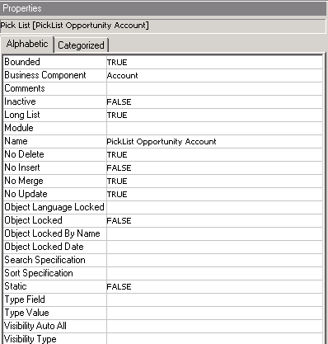
1. Define the Dynamic Picklist
Create a Pick List object definition
  Set the Business Component property to the name of the pick business component
Pick business component
Determines whether users can add or delete records through picklist
Leave blank for dynamic picklists
Notes:
The first step that is required is to define the dynamic picklist.
In order to create a new picklist definition, you can navigate to the picklist object in the object explorers window and create a new record. You will need to set the appropriate properties for the new picklist just like you did for the static picklist. There are a few properties that we want to highlight as they should be treated differently. The Business Component property needs to be set as the name of the business component containing the underlying values, not “PickList Generic”.
So if we want to present a list of Accounts to users we place ‘Account’ in the ‘Business Component’ property, and if we wanted to show Employees this would be the ‘Employee’ business component.
Type Field and Type Value are not used for dynamic picklists (used only for static picklists discussed previously in the module).
The No Delete, No Insert, No Merge, and No Update properties specify the data manipulation operations that can be performed in the pick applet. For example, the slide shows No Delete set to True so Account cannot be deleted through the pick applet. You will need to set all of these properties accordingly.

Slide 20
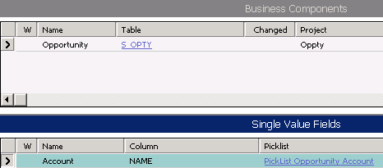
2. Associate the Picklist with a Field
Select the single value field to associate the picklist
  Determined by the list column or control in applet
Set the Picklist property to name of dynamic picklist
Originating BC
Notes:
Now once you have defined the dynamic picklist in the picklist object definition, you will need to specify the field that you wish to associate with this picklist value. You can do this in the business component.
What you will need to do is navigate to the business component object in the object explorer and select a business component. Then you will need to navigate to the single value field object and pick a field to associate with the picklist.
In the example above, we are using the Account field in the Opportunity business component. In the Picklist property of this field we will populate the name of the picklist that we just defined in step 1. Therefore this slide shows the picklist ‘PickList Opportunity Account” being associated with a field in the (originating) business component. Recall that the originating business component is simply the business component from where we invoke or request the picklist.

Slide 21
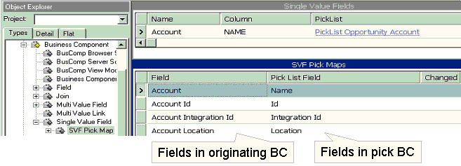
3. Specify Mappings
Create SVF Pick Map definitions to:
  Map fields in the pick business component to the respective joined fields
    Updates the values displayed in the applet
  Map the primary key field in the pick BC to the foreign key field
    Updates the FK field so new values are retrieved in future
Notes:
Step 3 in creating a dynamic pick list is to create a Single Value Field Pick Map definition. This step determines what field will be populated when a picklist value is selected and what data to copy. This slide shows how to create a SVF (single-value field) Pick Map definition that specifies what field is to be populated with what data from the picklist.
You will need to navigate to the SVF Pick Map when you have the Single Value Field selected. From here you will need to add new records and set the Field and Pick List field properties.
As a result of the above configuration, if a user selects a new Account from the picklist, Account Id is stored in the S_OPTY table to reference the newly picked Account.
In addition, because the Pick Maps for Account, Account Integration Id, and Account Location, the list columns in the Opportunity List Applet that map to these fields get immediately refreshed with the newly picked information.
This mechanism of using Pick Maps to apply picked values to the List Columns occurs at the UI layer; there is no re-query of the database to retrieve the newly picked Account row from the database.

Slide 22
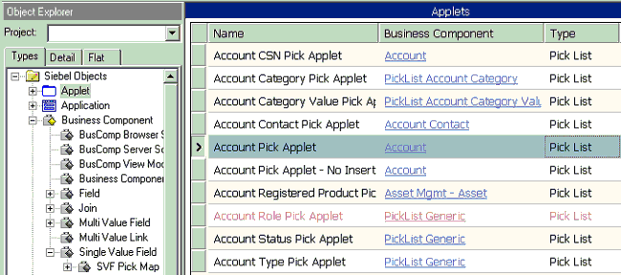
4. Identify or Create a Pick Applet
Identify an existing pick applet to display records from the pick business component
  Search for applets of Type Pick List that reference the pick business component
  Verify that applet displays enough list columns to allow user to distinguish the desired record
Notes:
Step 4 in the process of creating a dynamic pick list is to either identify an existing pick applet or to create a new one. In this slide we will describe how to identify an existing one to reuse.
To identify an existing pick applet you will need to perform a query in Tools in the Applet object for pick applets of type ‘Pick List’ based on the business Component you wish to display values from.
When the query returns the fields matching your specifications you would need to check that the list columns you wish to display to the user are contained in the pick applet, and in the order you desire. If you find one, you may use it as your pick applet. There should be enough list columns to enable a user to distinguish one record from another.

Slide 23
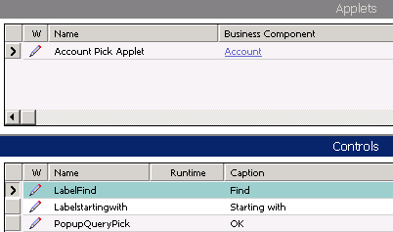
4. Identify or Create a Pick Applet Continued
If a suitable pick applet does not exist, create a new one
  Copy an existing pick applet
    Copies all controls required for pick applet
  Set the Business Component property to reference the pick business component if required
  Edit list columns as required
Pick applet controls
Notes:
This slide shows how to create a new pick applet. If no suitable applet exists, create your own. One quick method is to copy an existing pick applet; set the Business Component property, if necessary, to the one you desire and add or remove the number of list columns to suit your needs.

Slide 24
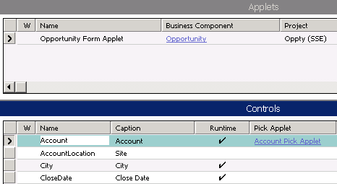
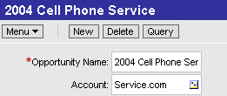
5. Enable User to Invoke the Picklist
Identify the list column or control that references the field with the picklist
Set the Runtime property to TRUE
Set the Pick Applet property to the corresponding pick applet
Picklist icon displays when runtime set to TRUE
Notes:
This slide shows the final step in creating the dynamic picklist. It is similar to the final step for static picklists, but in addition, involves setting the Pick Applet property to identify the pick applet used to display the picklist.
As previously seen, we need to set Runtime to TRUE to tell the application that extra processing is required when displaying this list column or control.
In the Pick Applet property, we specify the name of the pick applet we identified/created to display to users. In this case we want to associate the AccountName control with the AccountPickApplet at run time.
Note the Select button which displays on the UI is a visual cue that a dynamic picklist is available.

Slide 25

Pick List Wizard
Use the Pick List wizard to create a new dynamic picklist
  Select the originating business component and field
  Select an existing picklist or create a new one
    Indicate the pick business component if a new list
Wizard can build new pick applet if desired
Notes:
This slide shows the Pick List Wizard that can perform all the previous configuration automatically for you. The wizard can also build the pick applet, if required.

Slide 26
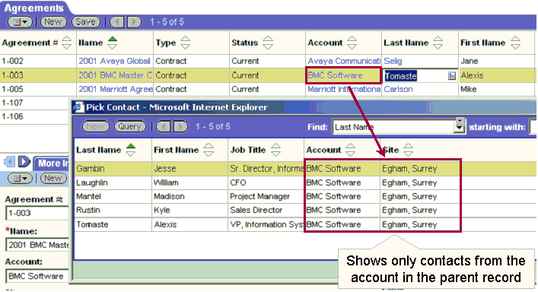
Constrained Picklist
Filters values dynamically to display only records with one or more fields that match corresponding fields in the originating BC record
Notes:
Now we will explain another picklist concept which is Constrained PickLists. Sometimes you may wish to filter the picklist values based on the values of other fields on the same record. This is a ‘constrained’ picklist.
The example in the slide shows a pick applet displaying contact records. But the only contact records shown are those for the Account “BMC Software.”
The next slide will explain how to constrain a picklist.

Slide 27
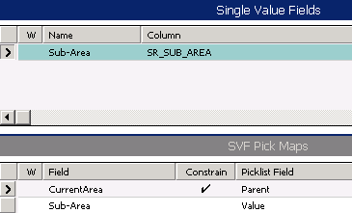
Constraining a Picklist
Create a pick map definition for each field that must match
Set the Constrain property to TRUE for each of the matching fields
  Filters the pick business component records for matches
  Does not copy values for the field
Constrained to return only Sub-Areas whose Parent is equal to the Current Area
Notes:
This slide explains how to set up a constrained picklist.
To configure a constrained picklist, you need to set the constrain property to TRUE in the SVF Pick Map object type.
A mapping is necessary to define a match between the originating business component fields and the pick business component fields. This is used to filter the list of records displayed in the pick applet to only those that have matching values in the corresponding fields in the originating business component and the pick business component.

Slide 28
Summary
This module showed you how to:
  Configure a picklist
  Describe the differences between drop-down lists and picklists
  Administer a list of values
  Configure a drop-down list
Notes:
Review Question: When might you use a picklist?
Answer: Because users are presented with a list of appropriate values, this means they do not have to remember all the possible valid entries. This reduces errors and makes data entry faster
Review Question: What does setting Runtime to TRUE do?
Answer: By specifying Runtime to TRUE, we tell the application that extra processing is required when displaying a list column or control

Slide 29
Lab
In the lab you will:
  Create a new dynamic picklist
Notes:
See 29-2 lab instructions for details.

